Slide 1

Industrial robot in harsh conditions Progress Review 2
Kin Tung
Eren Pekgöz
Daniel Pedraglio O'Hara

Slide 2
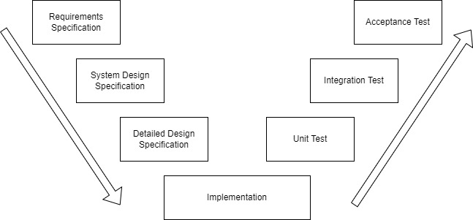
Current Project Status
Prototyping
Where we are

Slide 3
Current Project Status (Cont’d)
Unit Test
End Effector ✔
Robot Manipulator ✔
Bolt Tray ✔
Integration Test
End Effector and Robot Manipulator ✔
Robot Manipulator and Bolt Tray

Slide 4
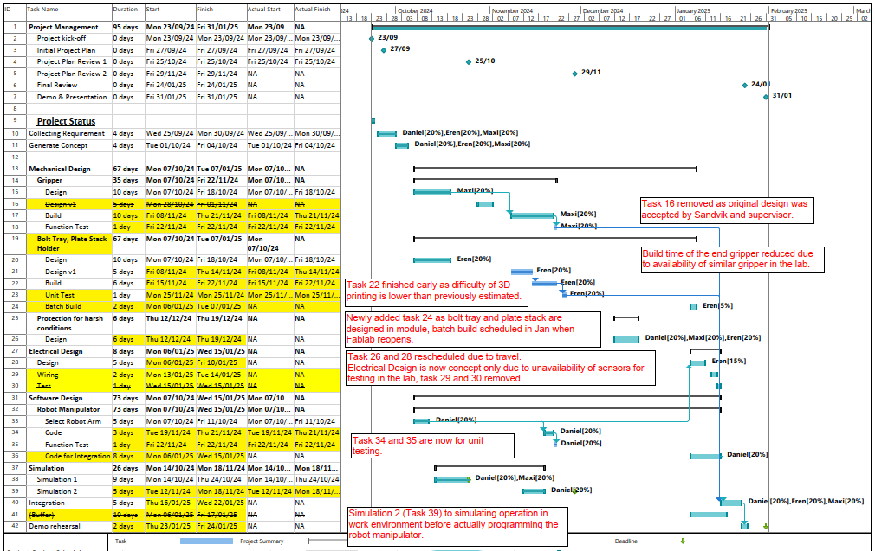
Project Schedule Update
Some changes after design review with Sandvik reps and our supervisor, and actual fabrication for the prototype.
Highlights (compare against initial plan):
Early completion of building end effector.
Early completion of unit testing of manipulator and end effector.
Project remains on schedule.

Slide 5
Remaining Tasks
Programming robot manipulator for demo
Fabricate the remaining parts (bolt tray)
Integration Test between manipulator and bolt tray
Acceptance Test
Final Video
Project Report

Slide 6
Design v1

Slide 7
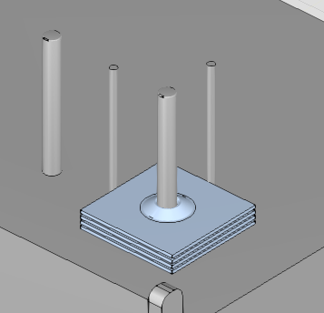
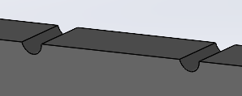
Rebar Guide & Plate Stack Holder
Addition of Plate Stack Aligners
New design of the slot on rebar guide

Slide 8
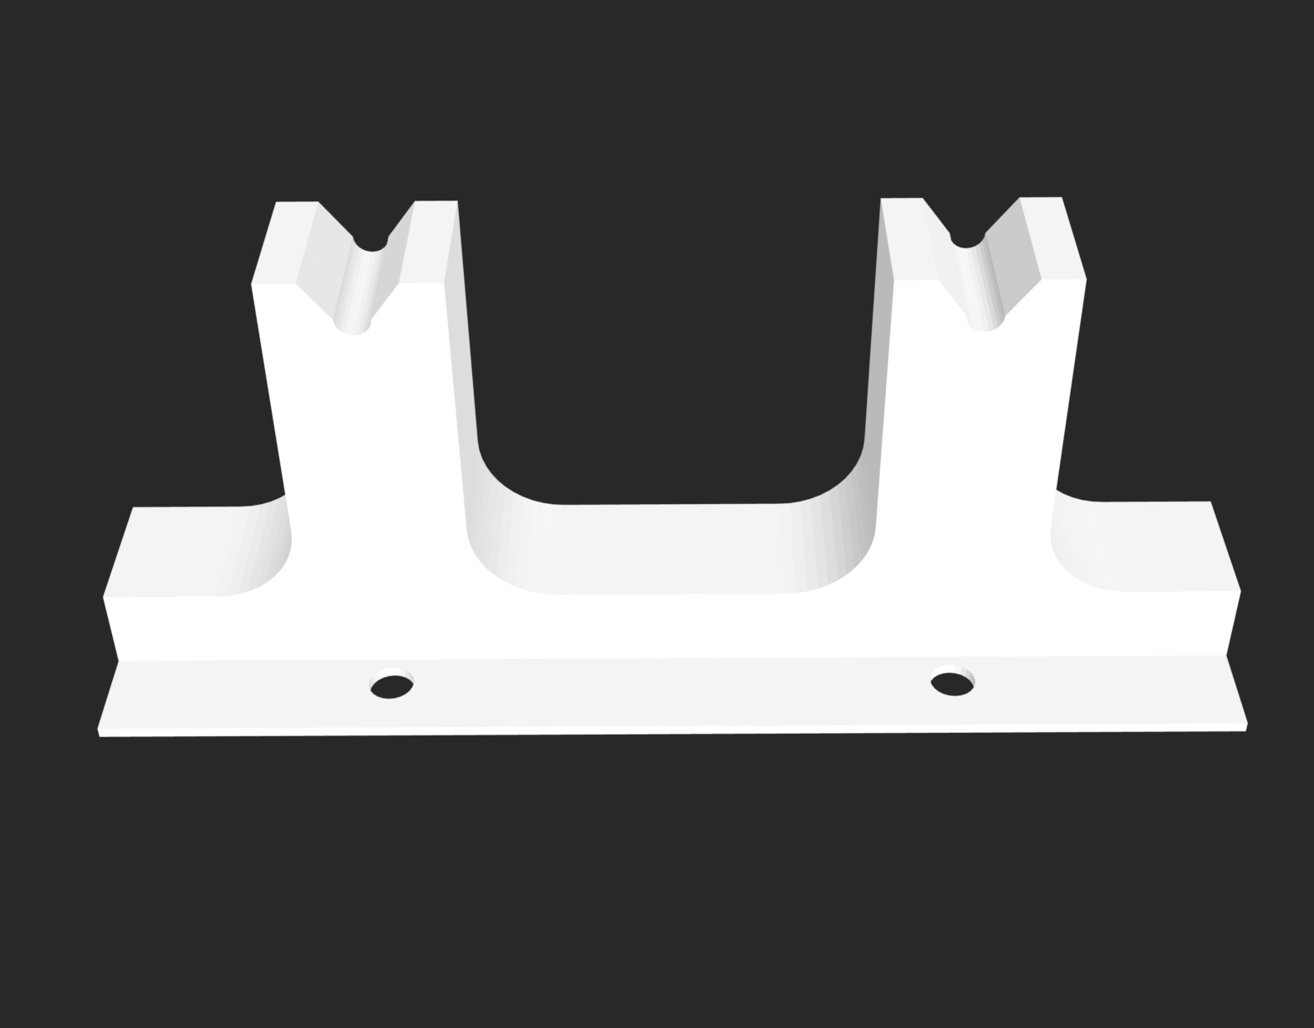
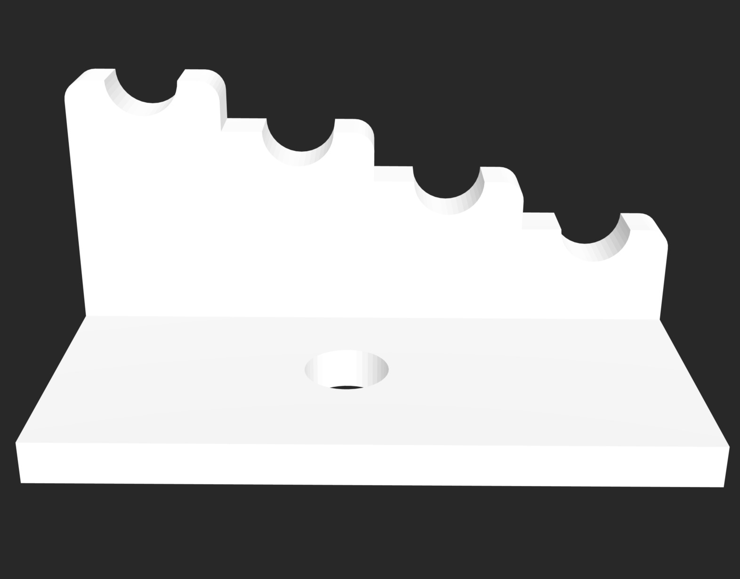
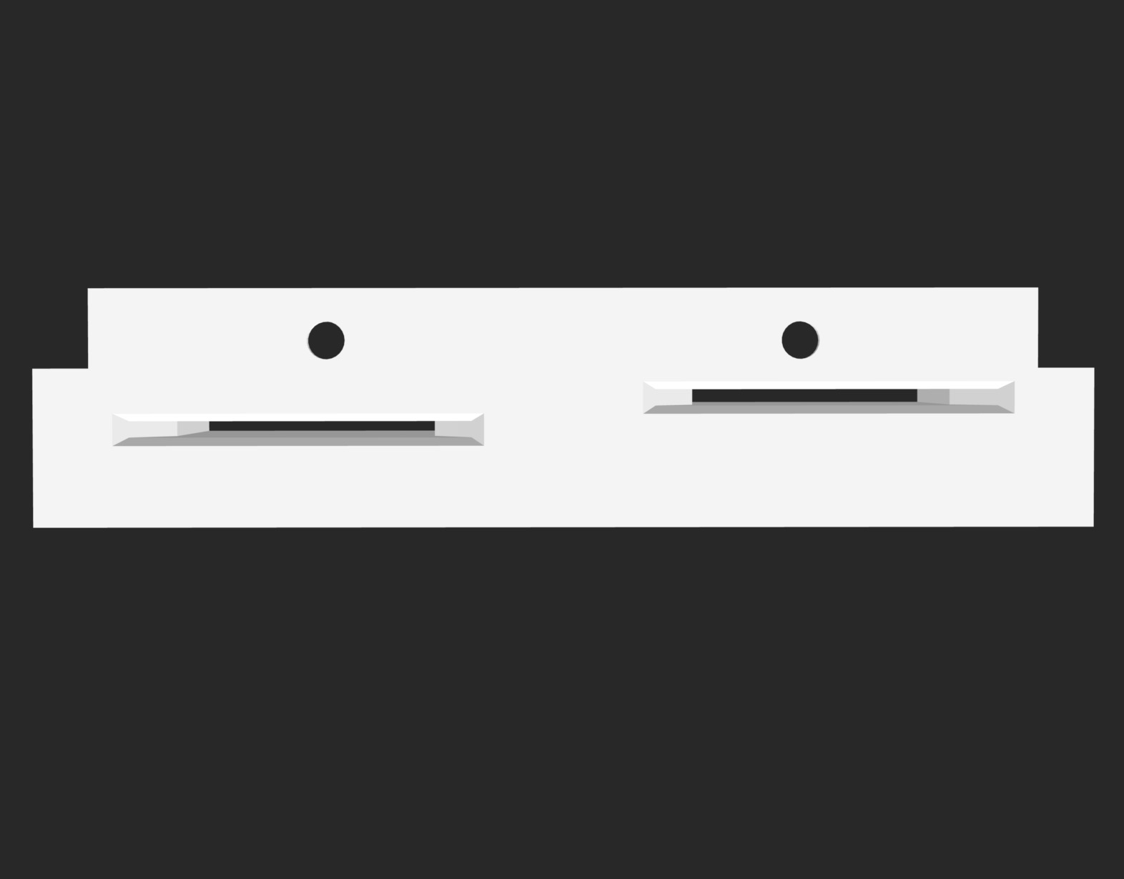
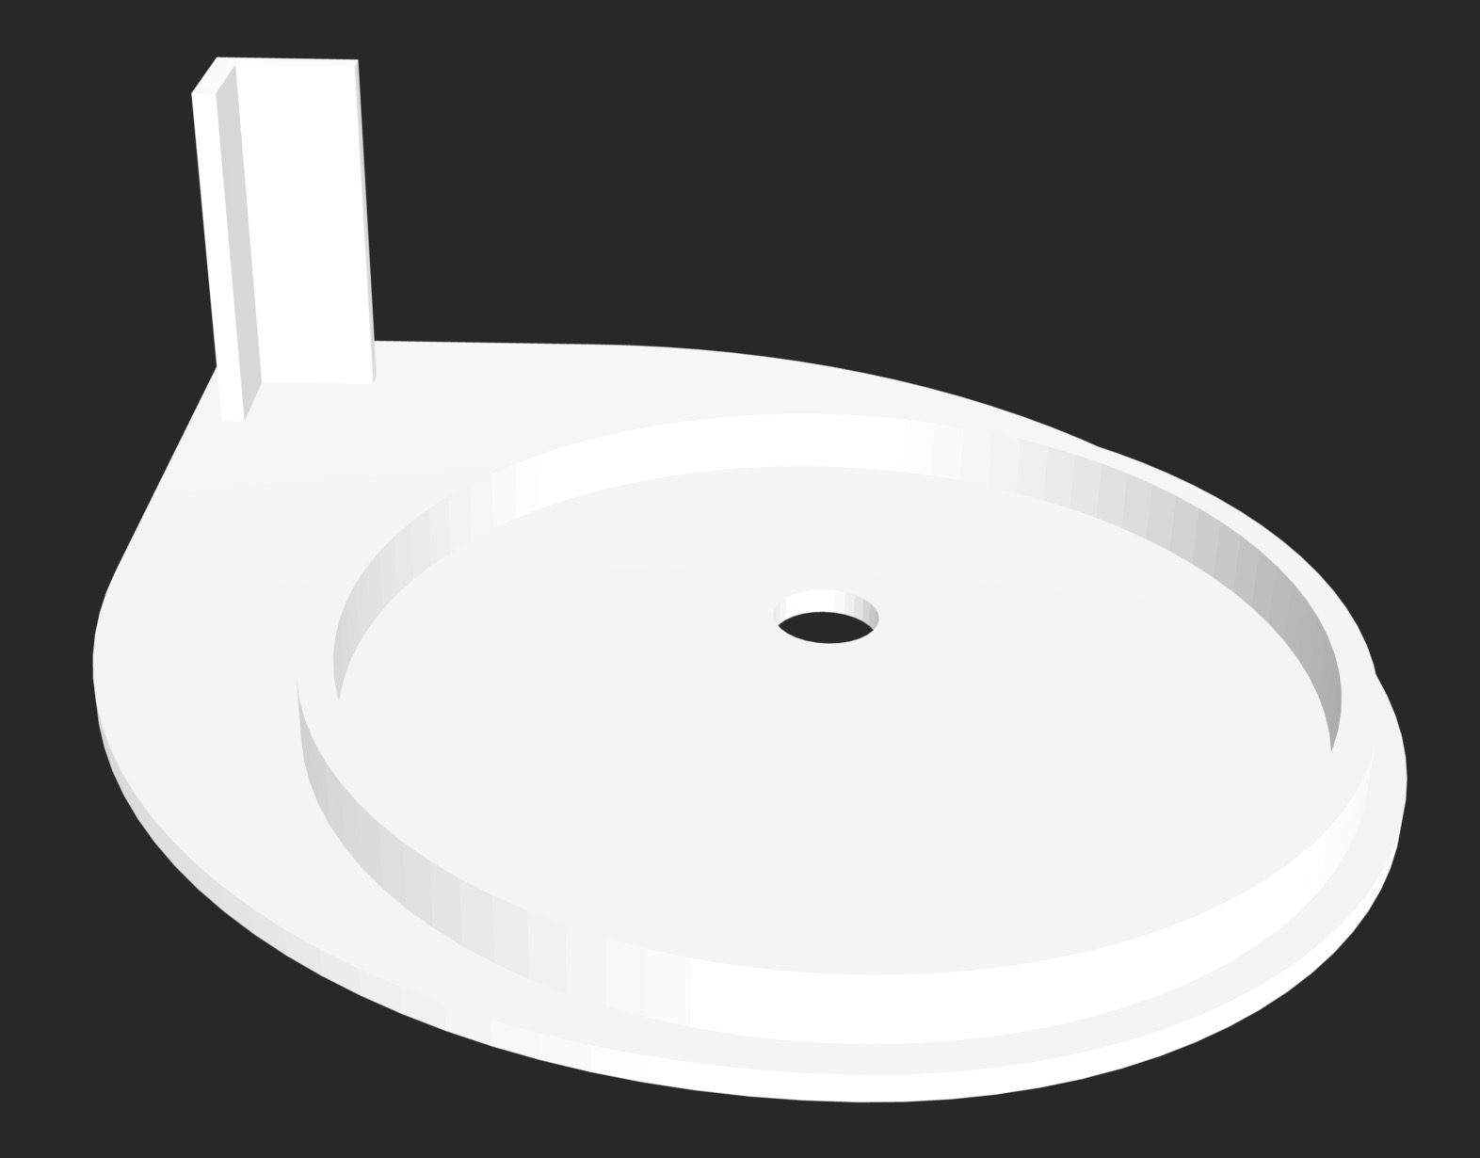
Rebar Guide & Rack ------ Plate Guide & Stack Holder
3D Print
Aligns rebars with the hole on the plates
3D Print
Keeps the rebars in different heights before placing on the tray
3D Print
Aligns the plates to be assembled with the rebars. Plates fall into the alignment due to angled edges
3D Print
Keeps the plates to be picked one by one on top of one another. Angled bracket on the corner keeps them aligned

Slide 9
Prototyping

Slide 10
Bill of Materials
Item No. |  | Description | Model | Material | Qty
1 |  | End Effector
 | 1.1 | End Effector Body | - | 3D Print (PLA) | 1
 | 1.2 | Pneumatic Magnetic Gripper | Ixtur MAP-6 | Steel | 1
2 |  | Robot Manipulator | UR5 | - | 1
3 |  | Bolt Tray
 | 3.1 | Modular Rebar Guide | - | 3D Print (PLA) | 4
 | 3.2 | Modular Plate Guide | - | 3D Print (PLA) | 2
4 |  | Rebar Rack | - | 3D Print (PLA) | 1
5 |  | Plate Stack Holder | - | 3D Print (PLA) | 1
6 |  | Fasteners | - | Stainless Steel | 1 Lot
7 |  | Metal Plate 100 x 100 x 3mm | - | Steel | 4
8 |  | M6 Screw Rod Length: 50mm | - | Steel | 4

Slide 11
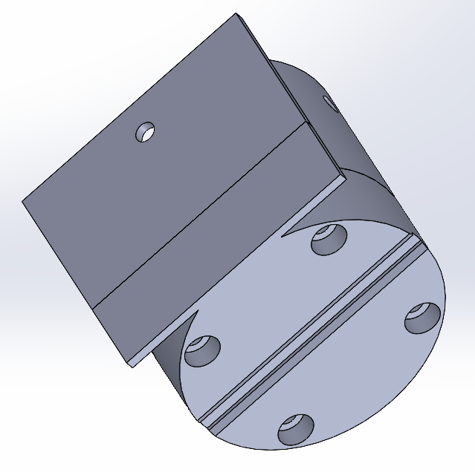
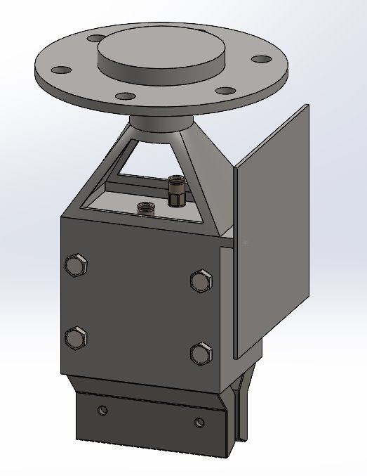
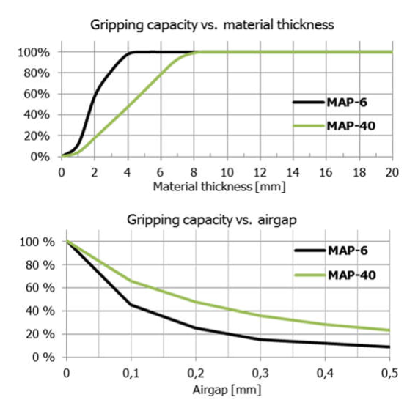
End Effector
Flat surface for pushing the rebar
Same type of gripper as in the design
Pneumatic Magnetic Gripper
Challenge:
Plate slipped off the surface during rotation around x- and y- axis due to reduced gripper capacity and gripping position
Gripping capacity (0.2mm padding):
6kg*0.85*0.25 = 1.275kg
Groove for keeping orientation of the rebar
Flat surface for holding the plate
Concept Design
Design for Prototype
~85%
3mm
~25%
Ixtur MAP-6 Pneumatic Magnet brochure
https://www.ixtur.com/wp-content/uploads/2023/08/Brochure_MAP-6-40_ENG_112018.pdf
0.2mm

Slide 12
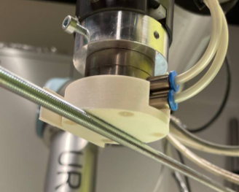
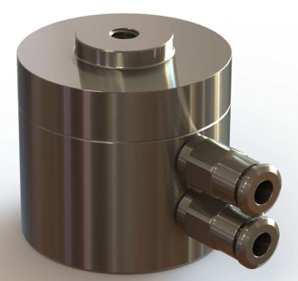
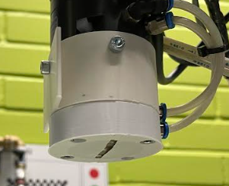
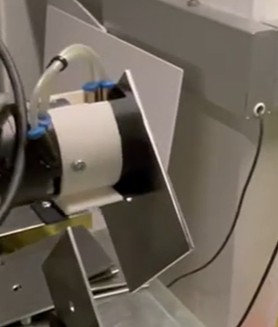
End Effector (Cont'd)
1.5mm padding
Ixtur MAP-6 Pneumatic Magnet user manual
https://www.ixtur.com/wp-content/uploads/2023/08/map6_product_instructions_eng_2022_04_27.pdf
0.2mm padding
0.5mm padding

Slide 13
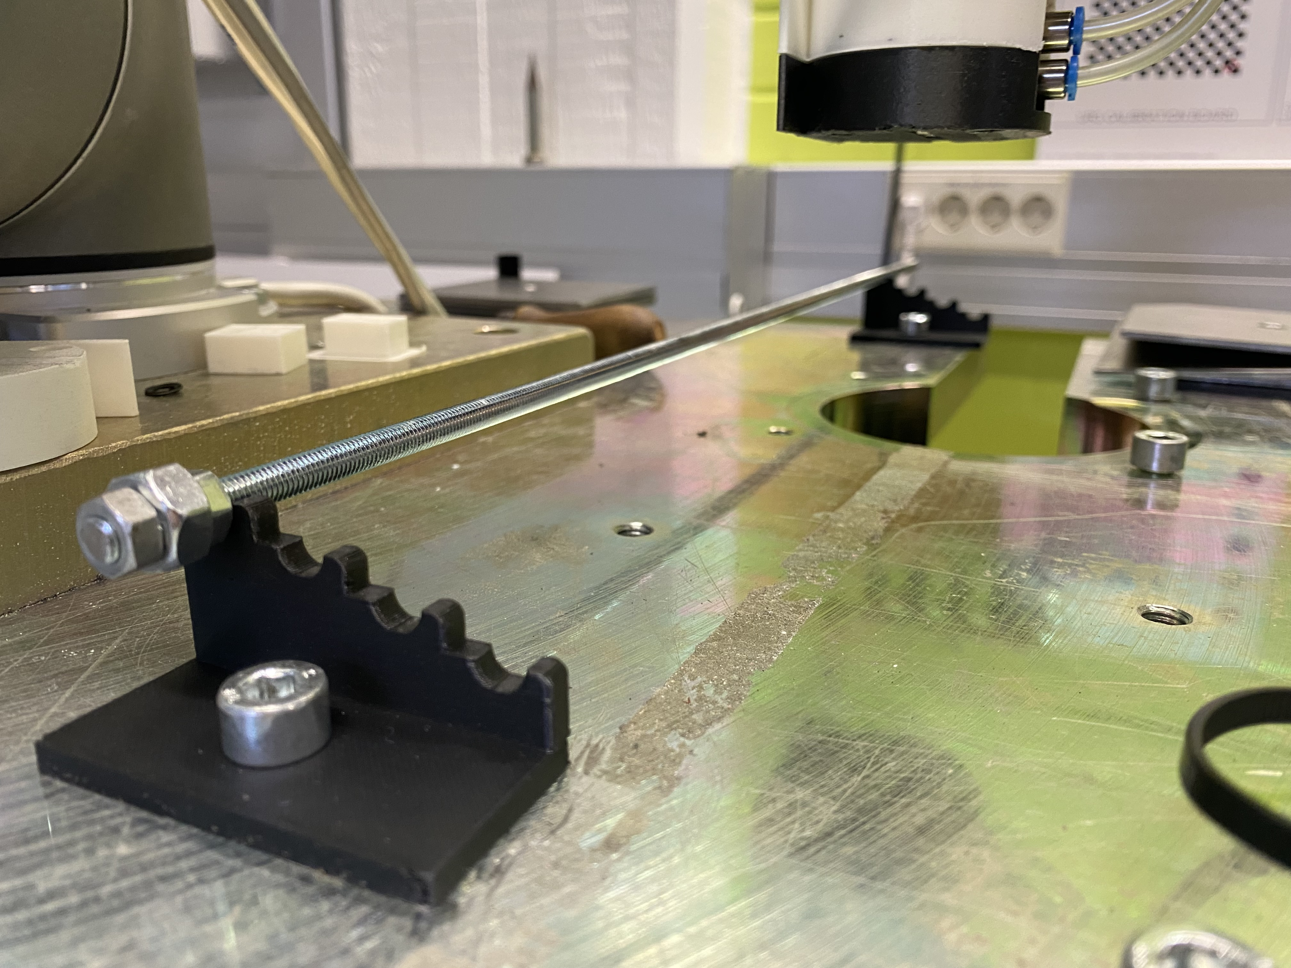
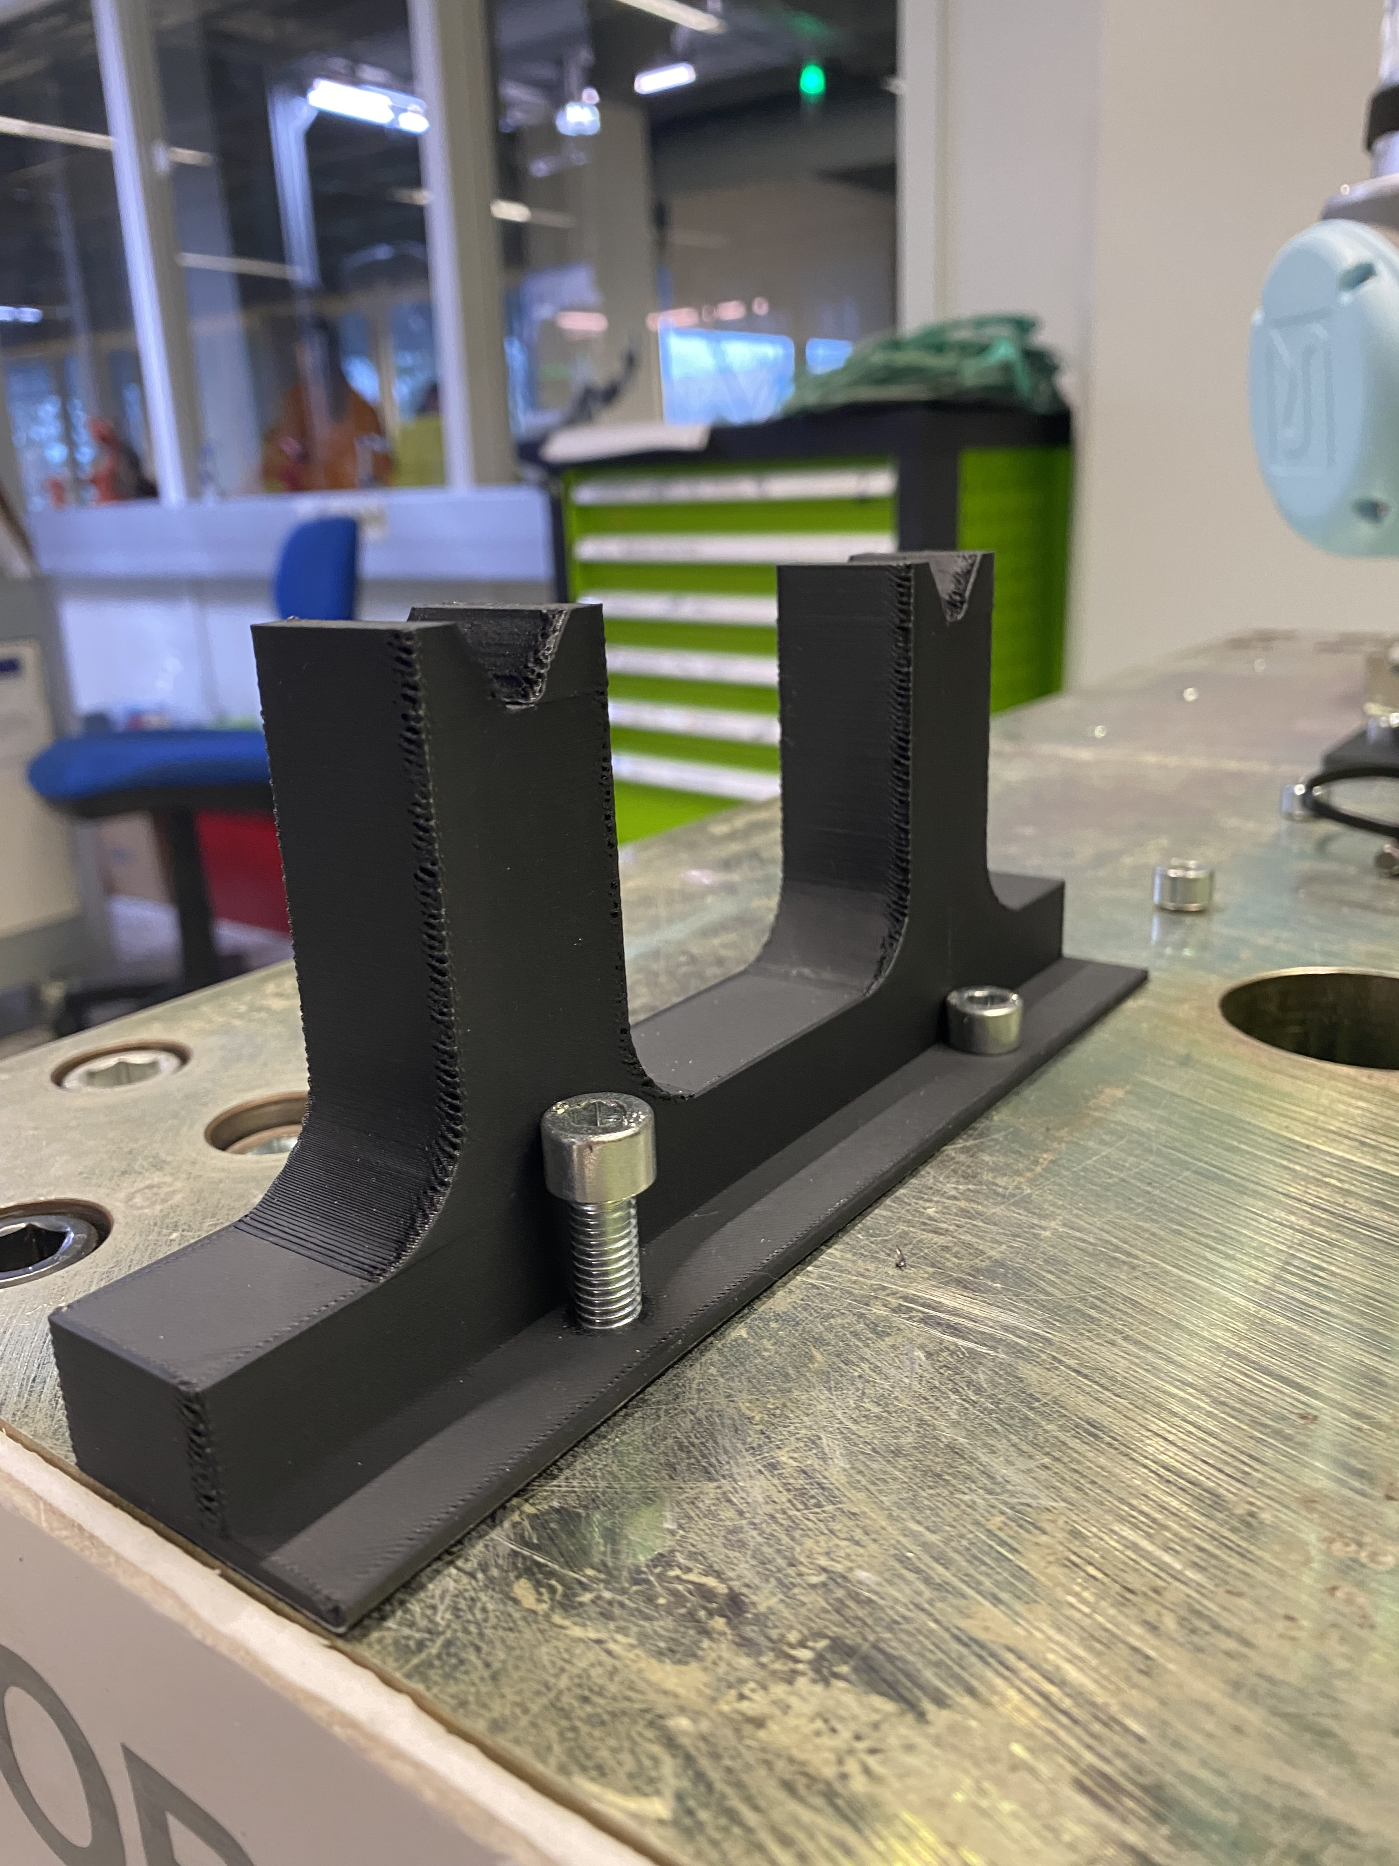
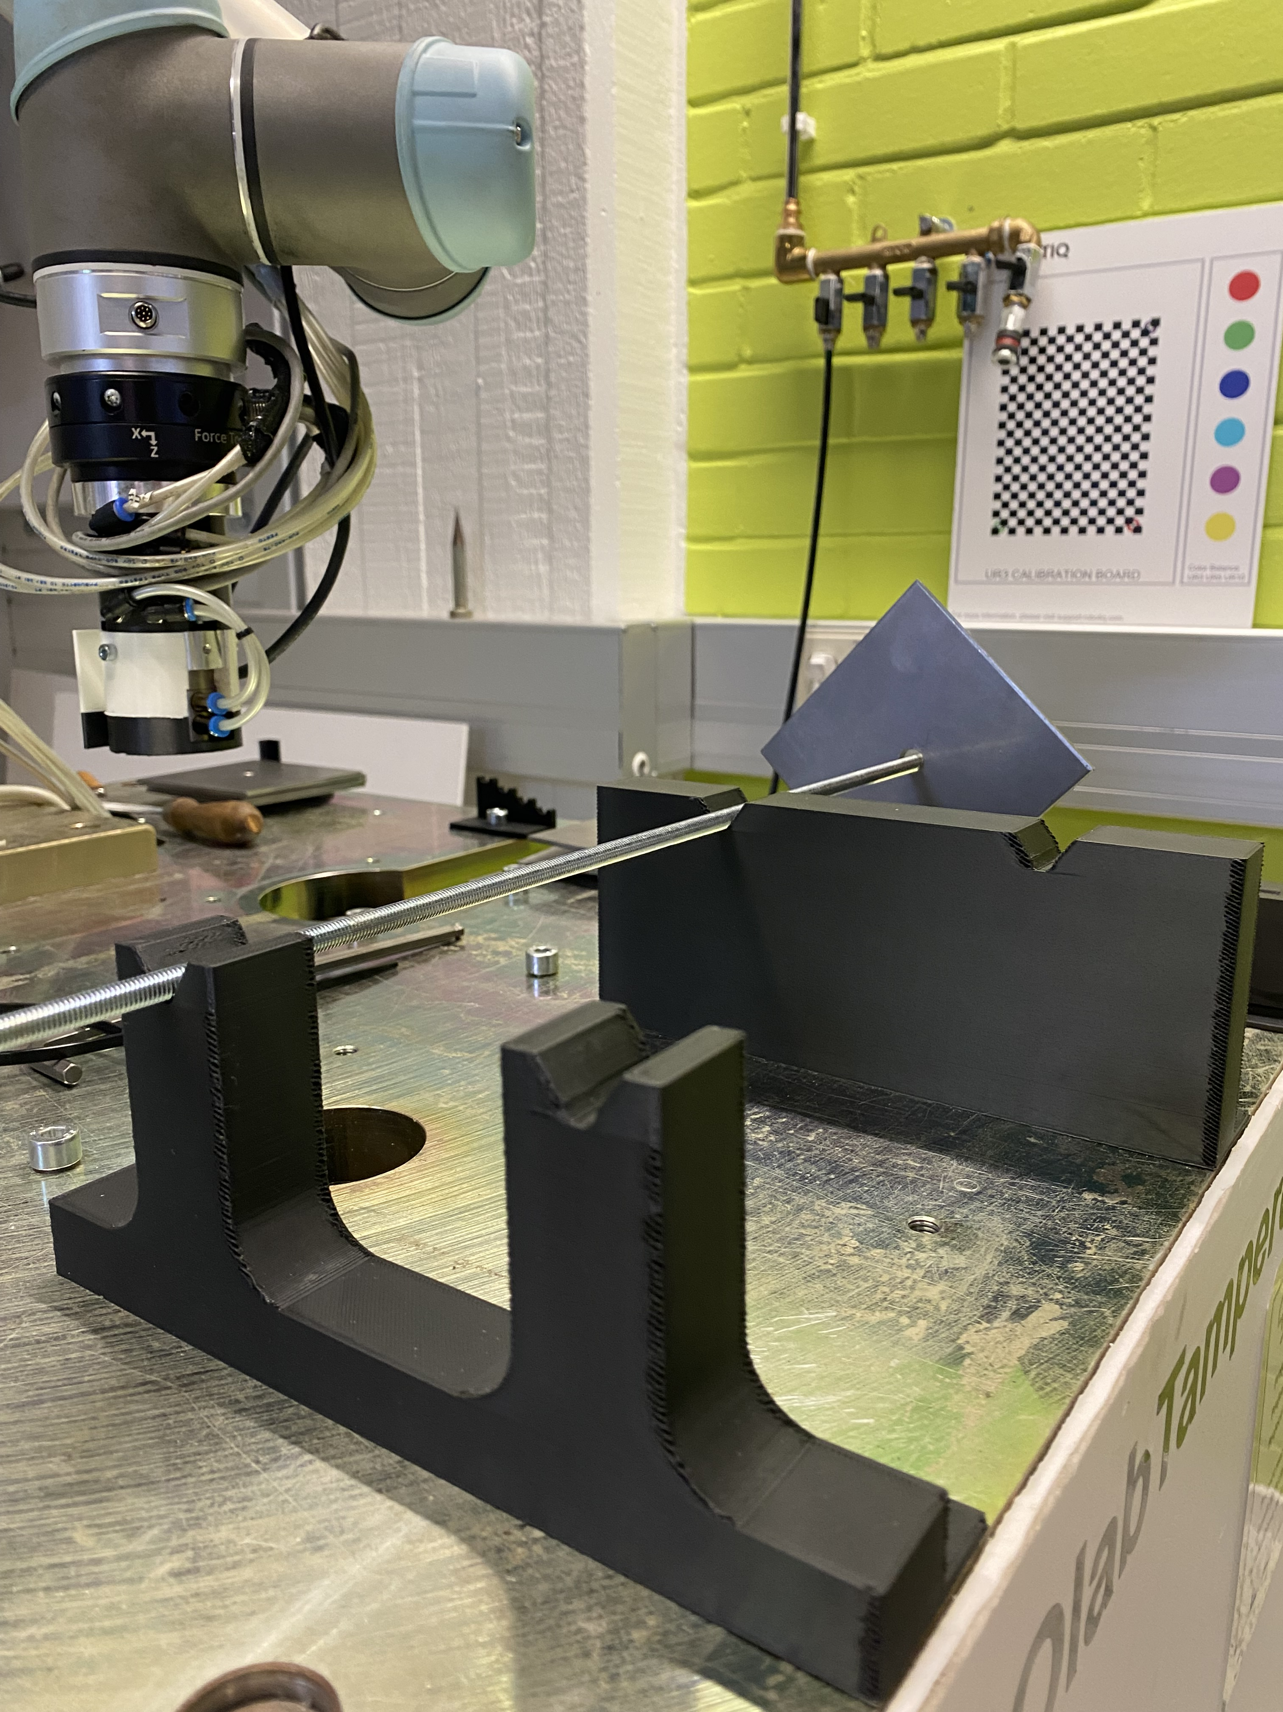
Rebar Guide & Rebar Rack
3D Print
Aligns rebars with the hole on the plates
3D Print
Keeps the rebars in different heights before placing on the tray

Slide 14
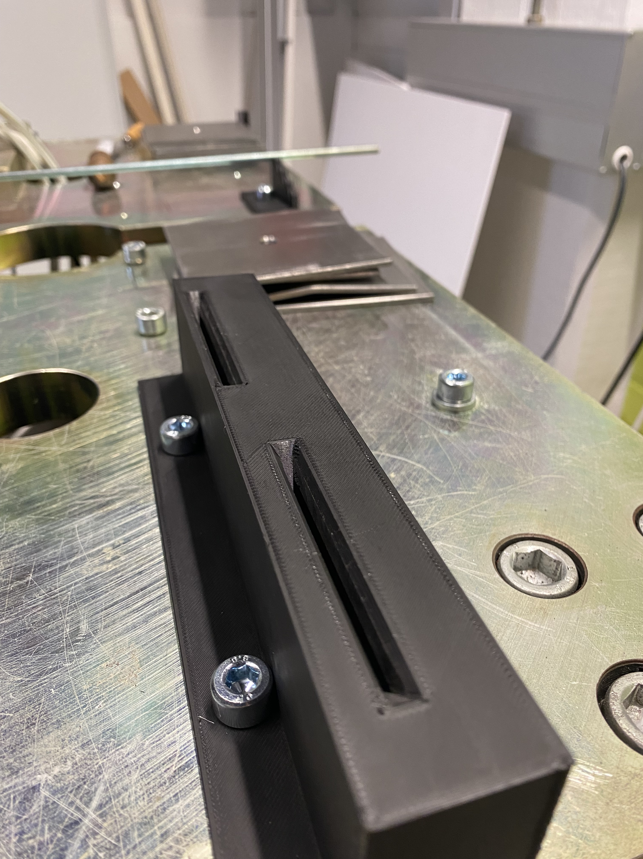
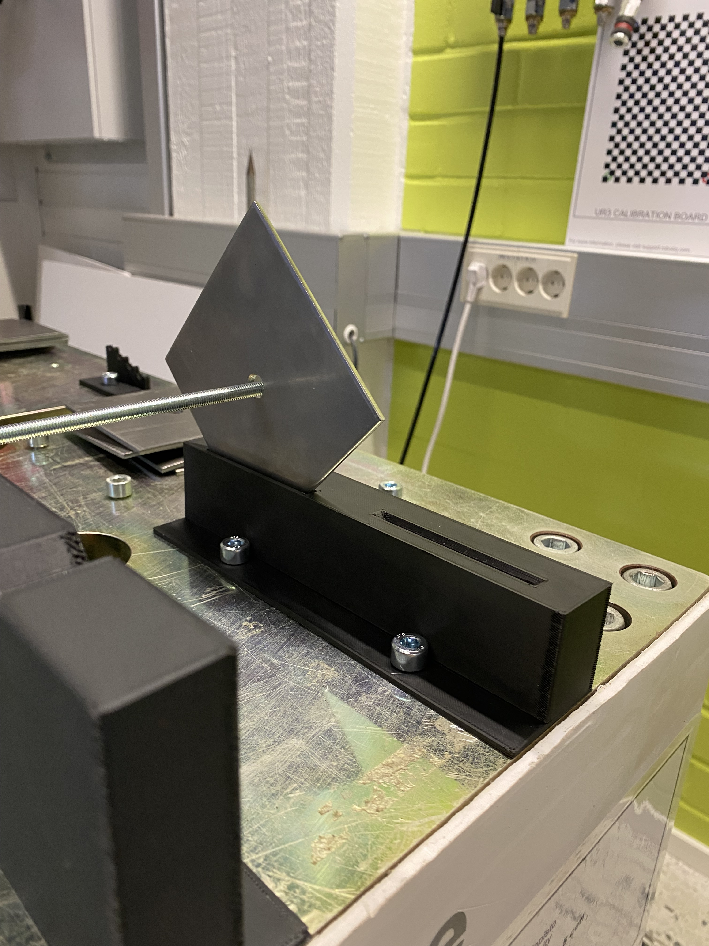
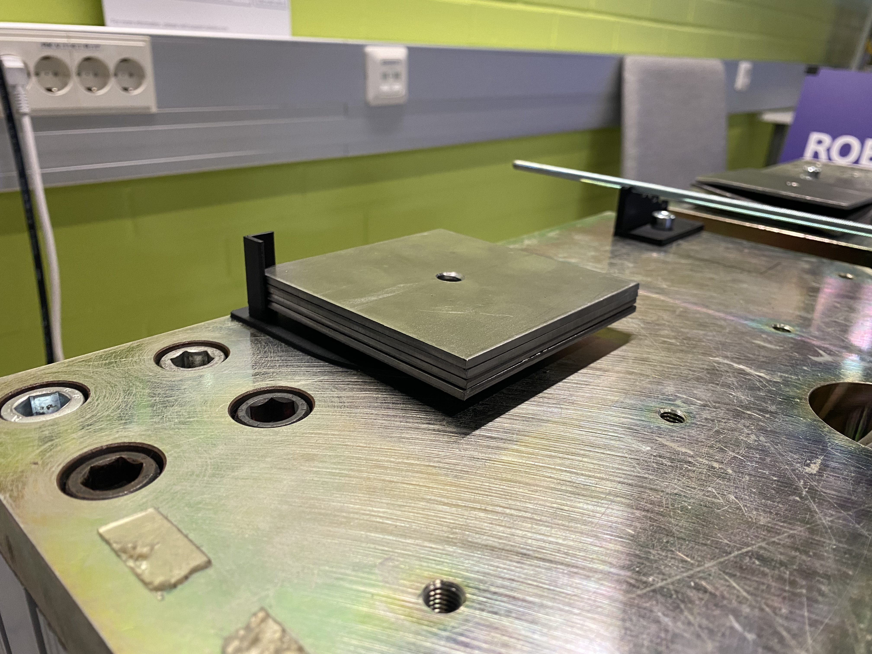
Plate Guide & Plate Stack Holder
3D Print
Aligns the plates to be assembled with the rebars. Plates fall into the alignment due to angled edges
3D Print
Keeps the plates to be picked one by one on top of one another. Angled bracket on the corner keeps them aligned

Slide 15
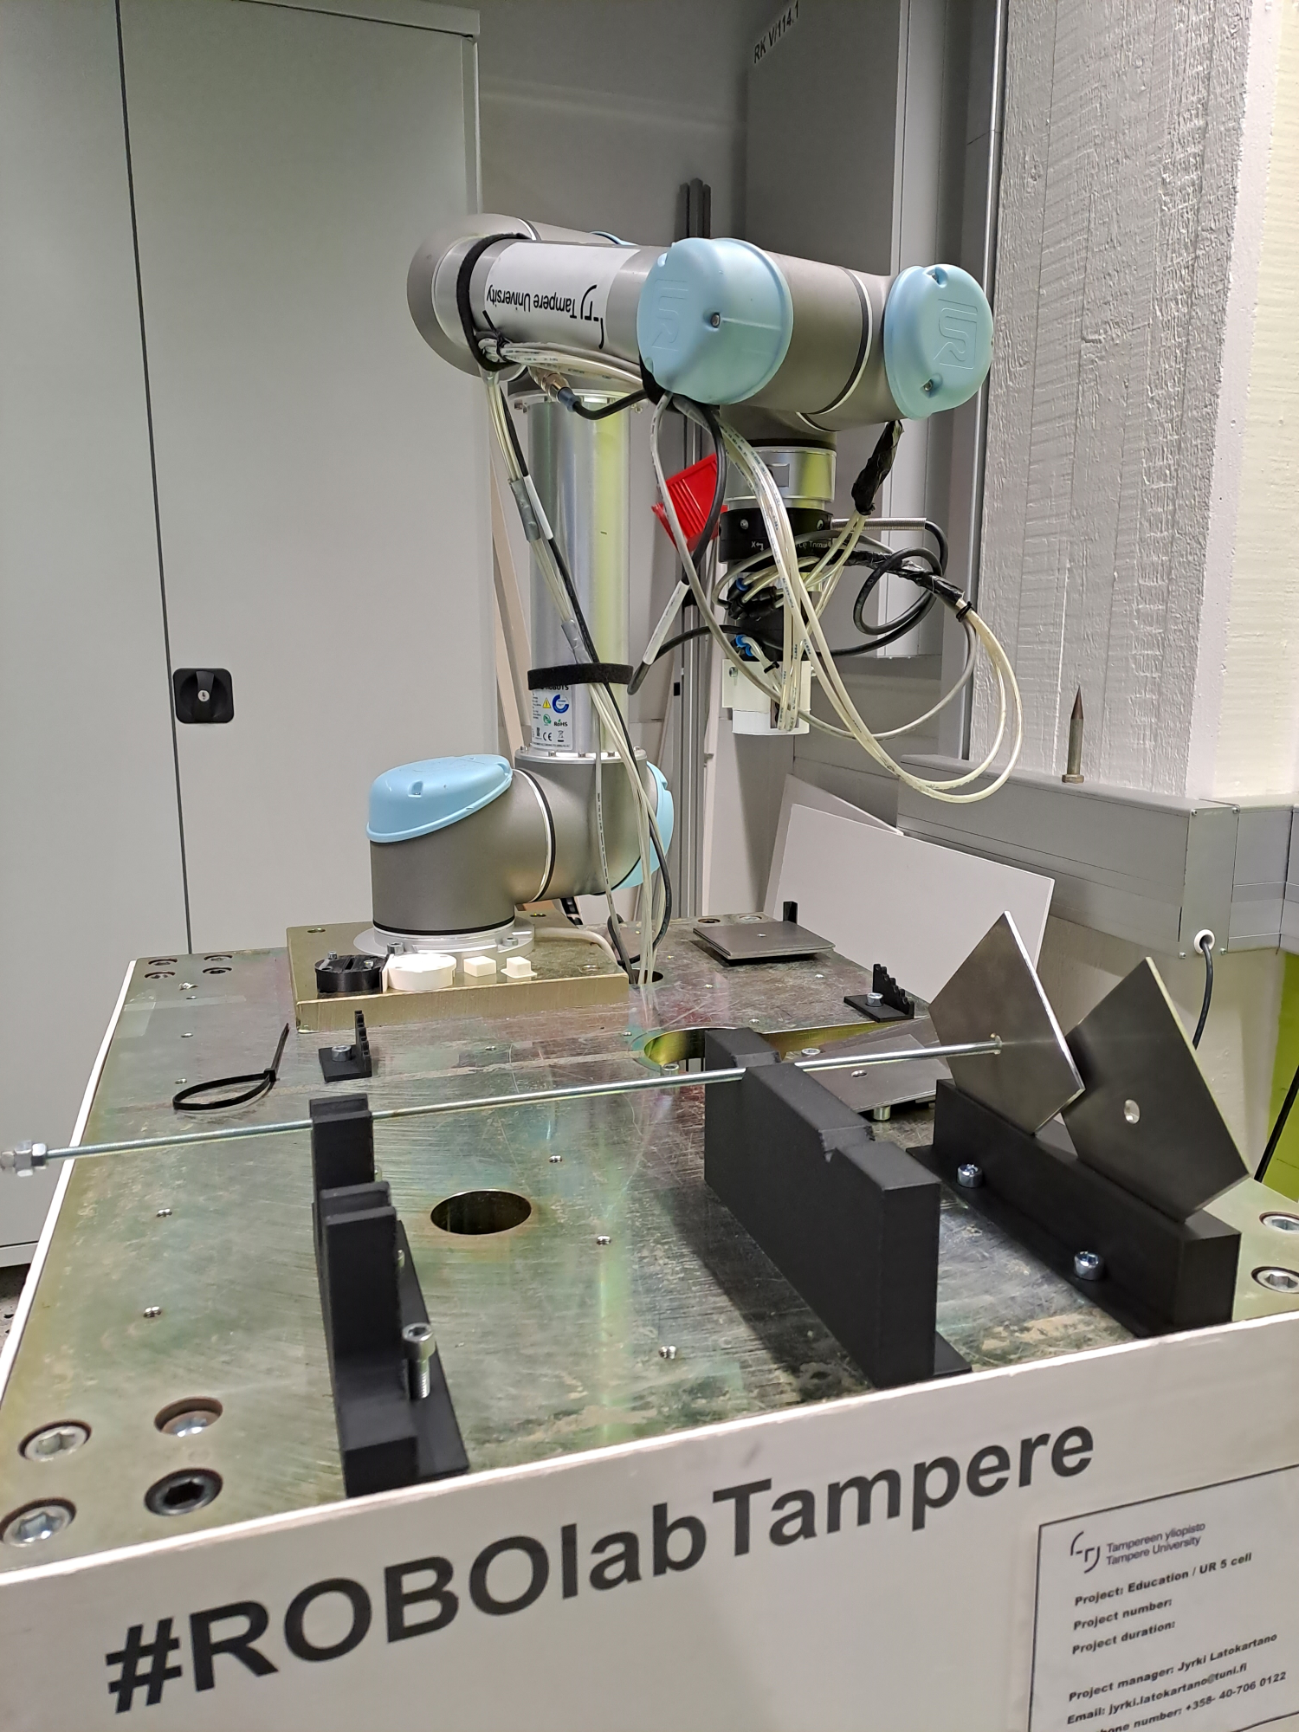
Robot Manipulator
UR5 robot in RoboLab.
Pneumatic lines to use the magnetic gripper.
Visual Components can export script for it.
PolyScope software with teach pendant.
Issues:
Rotating plate vertical.
Cables tangling up.
Joint angles to avoid hitting the tray or robot.

Slide 16
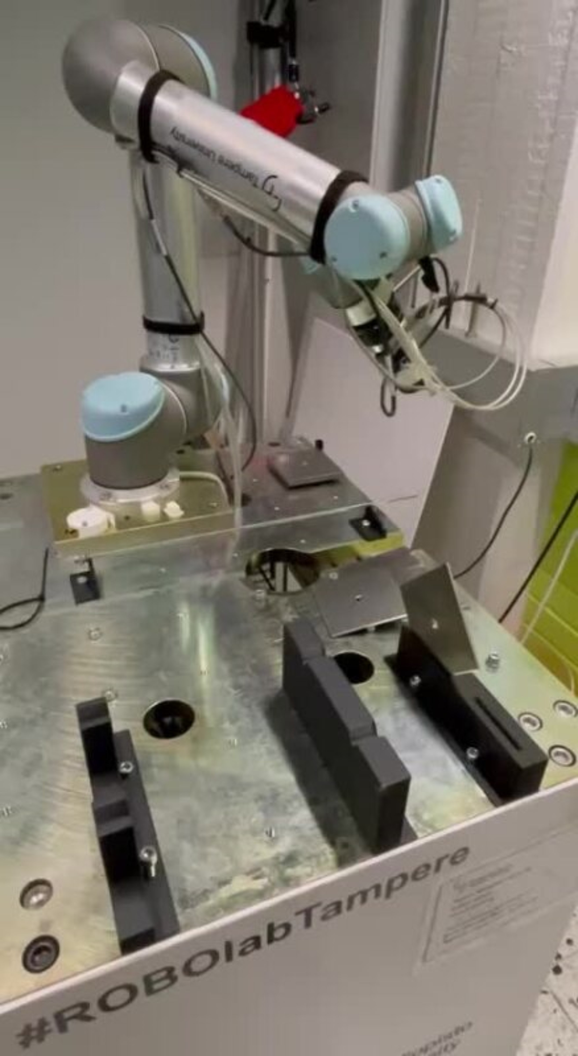
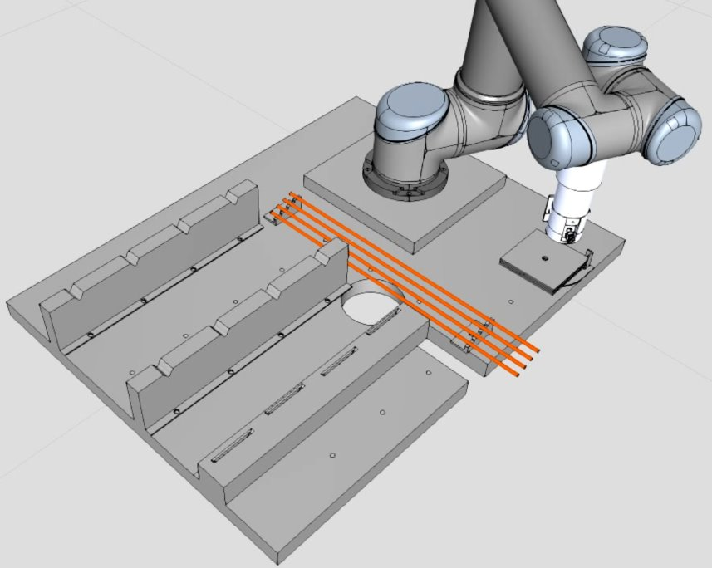
Video & Q&A

Slide 17
Thank you!

